Slide 1
Introduction to Data Science
TA section 10

Slide 2
Gaussian Mixture Models
Probabilistic model used for representing normally distributed subpopulations within an overall population.
Goal: model complex data distributions by representing them as a combination of several Gaussian distributions, each characterized by:
mean (μ),
variance (σ^2),
weight (which indicates the proportion of the population represented by each Gaussian component).
How? The parameters (means, variances, and weights) of the GMM are typically estimated using the Expectation-Maximization (EM) algorithm.
More details in jupyter notebook.

Slide 3
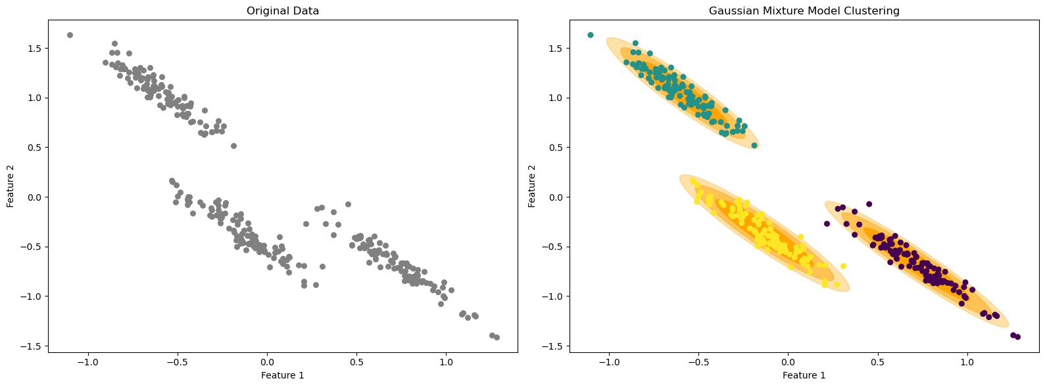
Gaussian Mixture Models

Slide 4
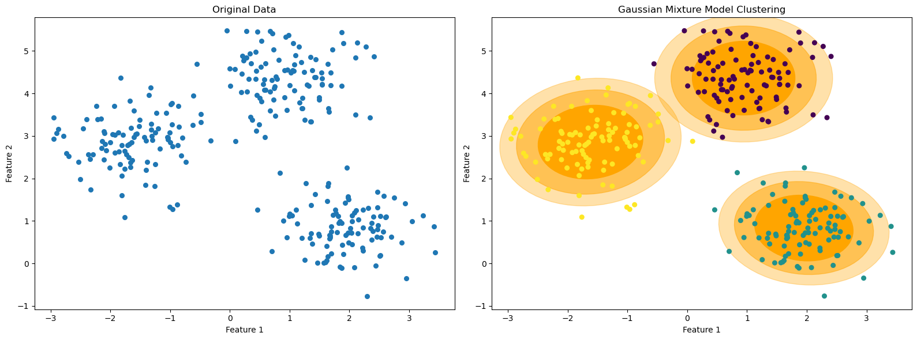
Gaussian Mixture Models

Slide 5
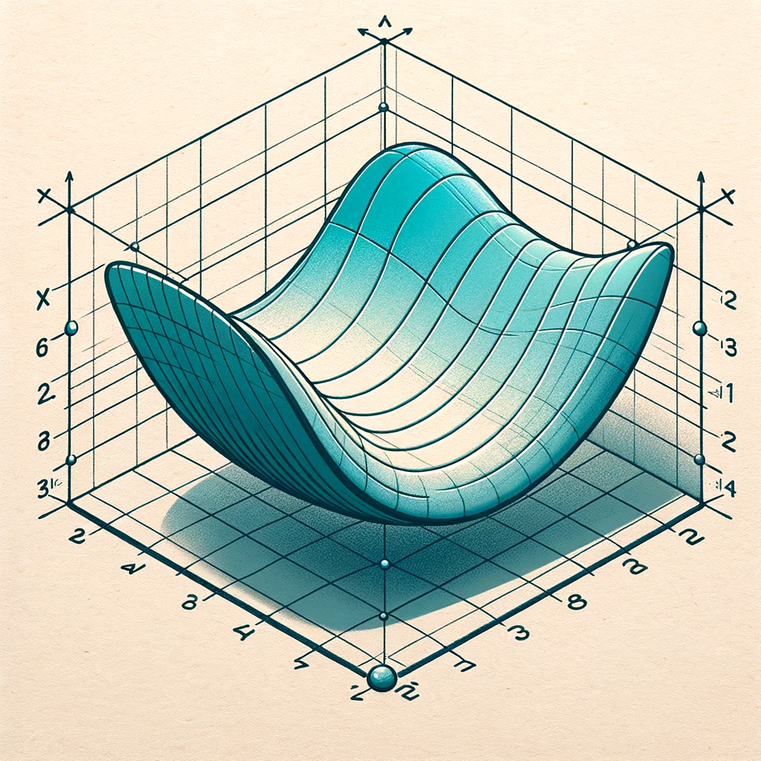
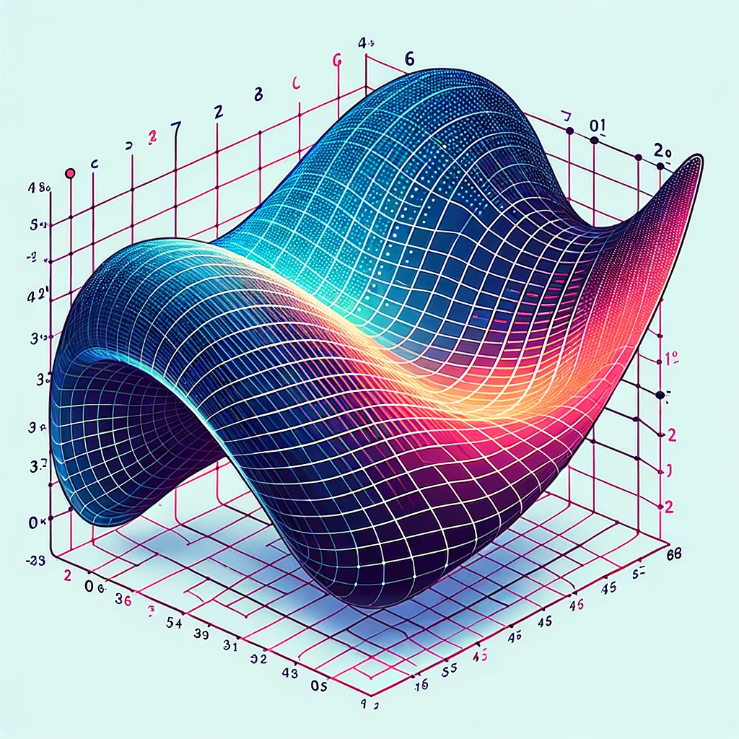
Manifold Learning methods
Type of unsupervised learning that aims to discover the low-dimensional manifold structure within high-dimensional data.
Core idea is that while data can exist in a high-dimensional space, it might lie on a manifold of much lower dimension.

Slide 6
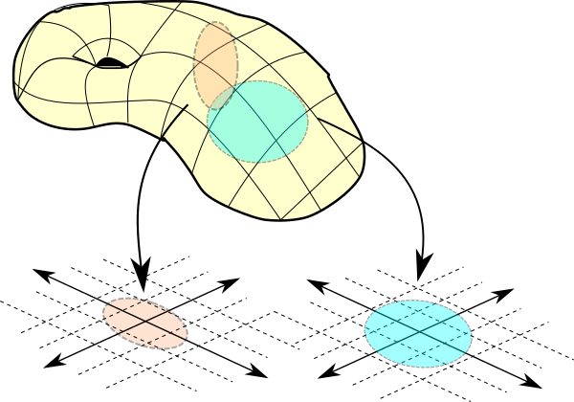
What is a manifold (small background)
A "manifold" is a concept from topology.
A space that might be high-dimensional overall but locally resembles a lower-dimensional space.

Slide 7
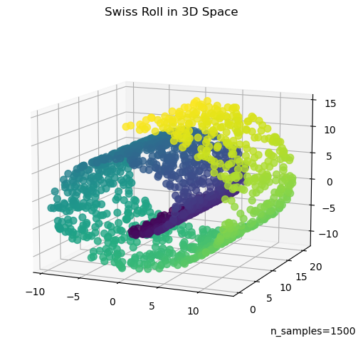

Slide 8
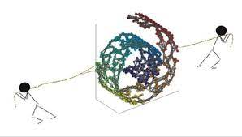
https://www.cs.cornell.edu/~kilian/research/research.html

Slide 9
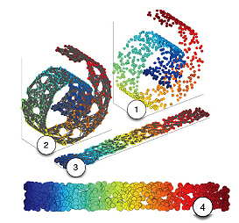
https://prateekvjoshi.com/2014/06/21/what-is-manifold-learning/

Slide 10
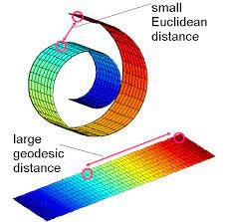
https://www.google.com/imgres?imgurl=x-raw-image%3A%2F%2F%2F320255955bcbe59b256822682b3f0cb2254f51df66c987962b89718c6ed99cad&tbnid=m-XLW5VVAjLG2M&vet=12ahUKEwj7mYO_5auCAxUsF2IAHSdqBbYQMygGegQIARBb..i&imgrefurl=https%3A%2F%2Fwww.cs.cmu.edu%2F~bapoczos%2FClasses%2FML10715_2015Fall%2Fslides%2FManifoldLearning.pdf&docid=iMQz_ooBQEpwcM&w=514&h=508&q=swiss%20roll%20manifold&hl=en&client=safari&ved=2ahUKEwj7mYO_5auCAxUsF2IAHSdqBbYQMygGegQIARBb

Slide 11
Spectral embedding
Type of dimensionality reduction technique that is particularly used for non-linear data structures.
It's a part of a broader family of techniques known as manifold learning.
Core idea
Find a low-dimensional representation of the data while preserving intrinsic geometry of the data manifold, which is an important characteristic of the data.

Slide 12
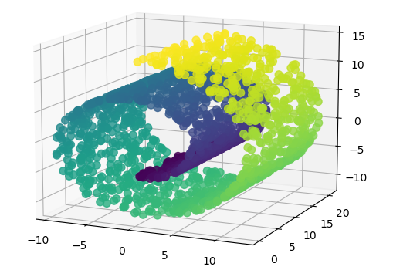
Example 1
https://www.geeksforgeeks.org/spectral-embedding/

Slide 13
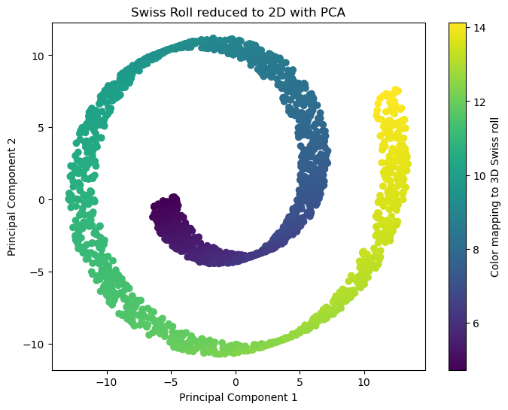
PCA not good enough
PCA failed to capture the structure of the Swiss roll and only projected it onto a plane.

Slide 14
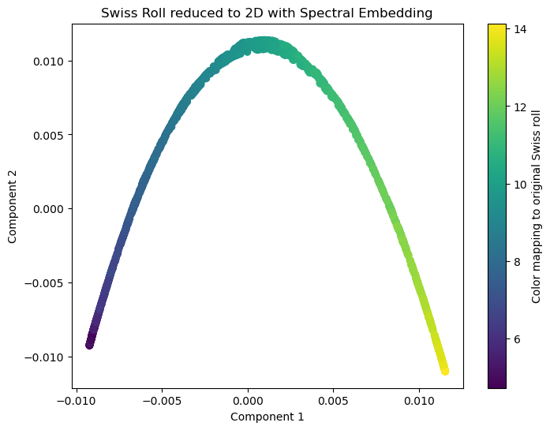
Spectral embedding comes in
Spectral embedding successfully unrolled the Swiss roll and preserved the colors of the original data. The embedded data has a linear shape that can be easily analyzed or clustered.

Slide 15
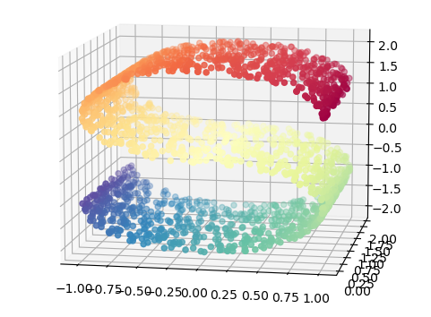
Example 2

Slide 16
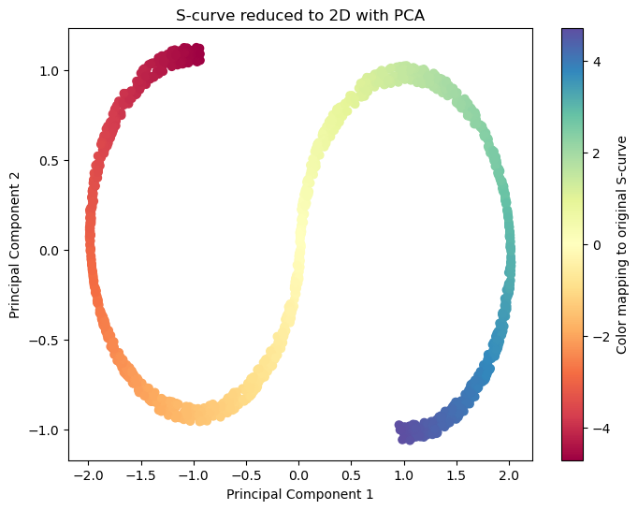

Slide 17
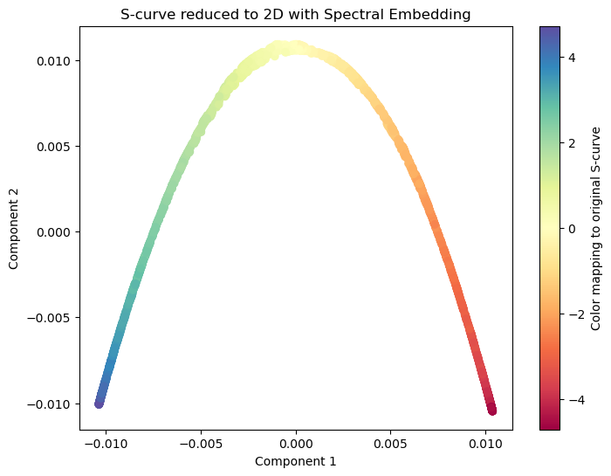

Slide 18
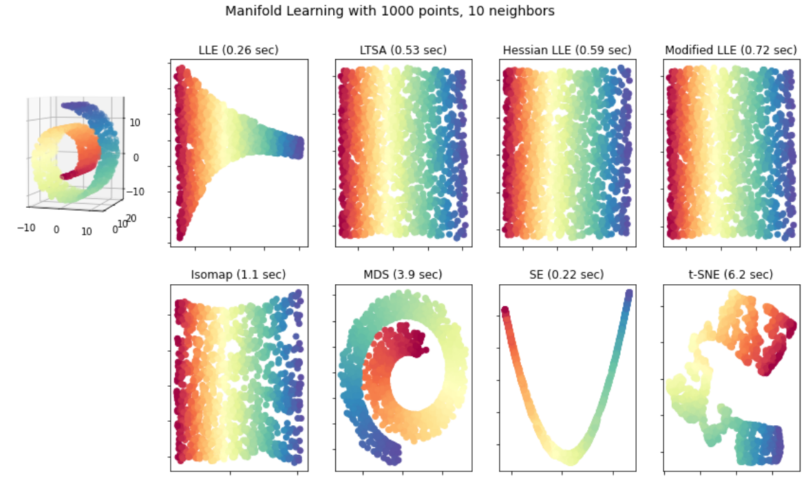
https://www.google.com/imgres?imgurl=x-raw-image%3A%2F%2F%2F320255955bcbe59b256822682b3f0cb2254f51df66c987962b89718c6ed99cad&tbnid=m-XLW5VVAjLG2M&vet=12ahUKEwj7mYO_5auCAxUsF2IAHSdqBbYQMygGegQIARBb..i&imgrefurl=https%3A%2F%2Fwww.cs.cmu.edu%2F~bapoczos%2FClasses%2FML10715_2015Fall%2Fslides%2FManifoldLearning.pdf&docid=iMQz_ooBQEpwcM&w=514&h=508&q=swiss%20roll%20manifold&hl=en&client=safari&ved=2ahUKEwj7mYO_5auCAxUsF2IAHSdqBbYQMygGegQIARBb#imgrc=tsT1JK9oMU_cxM&imgdii=lfGlpSwA2LjF7M

